Slide 1

#AgileCamp2019
@GoAgileCamp
AgileCamp
Estimation : Stop guesstimating and start sizing to reach predictability
Leo Mattos, Agile Delivery Operations CoE, SAP
@mattos_leonardo
Leonardo.mattos@gmail.com

Slide 2






MESSAGE FROM
LEO MATTOS
Agile Delivery CoE
Developer
Soccer coach
Adventurer
IT Services
Director
20+ years
In the industry
Licensed for kids
U10 - U16
Meyers Briggs
abbreviated test
Notes:
https://pixabay.com/en/write-plan-business-startup-593333/

Slide 3
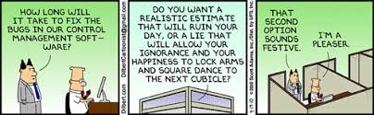
Story estimation
Estimation can be a difficult beast to deal with; more so on an agile project. How do you estimate when you don’t have a list of requirements that is complete or signed-off by the customer? Or a nailed-down schedule? What should your currency of estimation be? How do you estimate on distributed teams? Is it worth estimating at all?
Notes:
Lets start with a reflection on how do you guys do it today. What are the biggest challenges you face on estimation? Acurracy?
Estimation can be a difficult beast to deal with; more so on an agile project. How do you estimate when you don’t have a list of requirements that is complete or signed-off by the customer? Or a nailed-down schedule? What should your currency of estimation be? How do you estimate on distributed teams? Is it worth estimating at all?
Estimates also set expectations, and since estimates are usually too low, they set unrealistic expectations. Any increase in time or reduction in features is then seen as a loss. Due to loss a version, these losses have a magnified effect.
Faced with situations like this, its easy to see how people turn their angry glares towards estimation. This leads to an increasing notion that everyone indulging in estimating is “Not a true agilest”. Critics of agile say this means that agile development is about developers going off and doing vague stuff with promises that it’ll be done when its done and you will like it.
I don’t share this view of estimation as an inherently evil activity. If I’m asked if estimation is a bad thing, my answer is that standard consultants’ answer of “it depends”. Whenever someone answers “it depends” the follow up question is “upon what”.

Slide 4

Why do we estimate?

Slide 5



Why do we estimate?
Plan acting *
Estimation is valuable when it helps you make a significant decision
Transparency on decision making
Coordination
Allocation of resources
* As baseline to help assess changes

Slide 6

What are the decision you think estimation can help with on your space?
Notes:
Now lets think together…. You can right down on your notes there : What are the decision you think estimation can help with on your space?

Slide 7
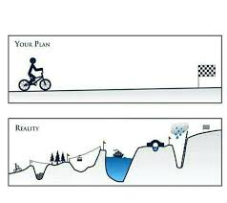
Estimation on Agile
Most difficult – if not the most difficult – aspects of the job.
Slew of factors that help product owners make decisions
Agile estimation is just that: an estimate. Not a blood-oath
Notes:
Estimation is hard. For software developers, its among the most difficult – if not the most difficult – aspects of the job. It must take into account a slew of factors that help product owners make decisions that affect the entire team – and the business. With all that at stake, it’s no wonder everyone from developers to upper management is prone to getting their undies in a bunch about it. But that’s a mistake. Agile estimation is just that: an estimate. Not a blood-oath

Slide 8
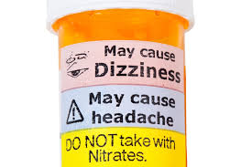

Side effects
If you get “too good” on estimating, you might stop doing it.

Slide 9
How do we estimate?
How do we size?

Slide 10






Why not hours?
Emotional attachment
Political
Not accurate anyway
Increase complexity
Reward the wrong thing
Notes:
Make an slide to open the discussion around why not hours. What is the problem with hours and why we should be doing relative estimation.
1) Not accurate anyway : Dates don’t account for non-project related work that inevitably creeps into our days : emails, meetings, and interviews that a team member may be involved in
2) Emotional : Dates have an emotional attachment to them. Relative estimation removes it.
3) Political : Each team will estimate work on slightly different scale, which means their velocity will naturally be different. This, in turn, makes it impossible to play politics using velocity as a weapon
4) More complex : Once you agree on the relative effort of each story point value, you can assign points quickly without much debate.
5) Reward the wrong thing ( Trophy ): Story points reward team members for solving problems based on difficulty, not time spent. This keeps team members focused on shipping value, not spending time

Slide 11
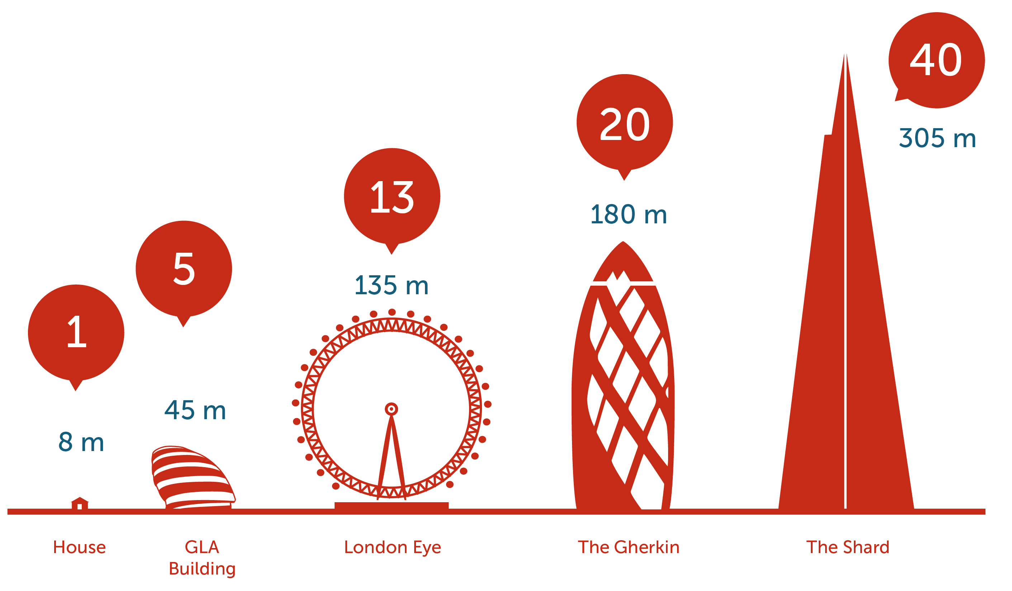
Relative estimation
Notes:
Why? Advantages
Comparing is faster than analyzing.
Comparing is usually more accurate than analyzing.
Comparing does not have the “accurate” feeling.
Estimating in arbitrary units lets you report on the natural wins and losses in a less confusing manner. Great week? “We finished 30 points!” Run into some difficulties? “We only finished 17 points.” You put forth the same effort in each case, so there’s nothing odd to explain.
Tracking your project velocity lets you turn your estimation units into actual time (and hence a calendar and cost for the business). It’s really simple: you simply measure and track the amount of work the team finishes in each iteration. The team’s velocity is the rate at which they can complete work. In our experience, teams takes 2-3 weeks (iterations, in our case) to find their stable velocity. Teams that have worked together before, or similar recent projects may even shorten this stabilization time.
If you’ve estimated the project in points, and you’re tracking velocity, then you simply divide the total number of points of work remaining by the velocity to know how many iterations you expect are required to finish the project. We usually report this to the customer with a burndown chart.
The final advantage I’ll point out about using relative complexity points and tracking velocity is the way they naturally account for the difference between an ideal 8 hour workday and the hacked-up, interrupted, full-of-meetings, occasionally longer-lunch, day. Team velocity represents the team’s capacity with all the messy details of real work situations already accounted for.

Slide 12





How to size effectively
This is a iterative process you must do during your PBRs ( my preference ) or as part of estimation meeting, for all stories marked as “ready” on your backlog.
Define the buckets you will have. My suggestion to have at most 4 buckets.
Always estimate stories against each other. We thus need a frame of reference, to relatively size stories
Relatively size each story against benchmark story by discussing only the implementation details that affect its size
Place each story into a bucket
At the end, for each story bucket, do a quick review of the stories in them. Validate they are all reasonably close in “size” to each other.
Notes:
On first point, if you have already some medium size stories, then use them. If not, select the one you think its medium size and use as reference to compare.
I always prefer to use just 3 scaled , that can be 2, 4 and 8. That is because I think that thinking inn term of numbers like ( double, half, triple is easier than compare t shirt sizes. )
At the last steps, its optional and needs to be done in group. You can shift the bucket if required.

Slide 13
Side effects
If you get “too good” on estimating, you might stop doing it.
Notes:
Many teams find that estimation provides a useful forcing function to get team members to talk to each other. Estimation meetings or PBRs, can help get better understanding of various ways to implement upcoming stories, future architectural directions, and design problems in the code base.
About the “stop doing” side effect, the rational is that part of the decisions to do an estimation is to predict when some item or feature will be done. So, when the teams mature on the estimating skills, usually is result on better and size standardized stories, which might drive to on spot estimation just for some specific decision driven by this info, and not predictability or previsibility of delivery.

Slide 14
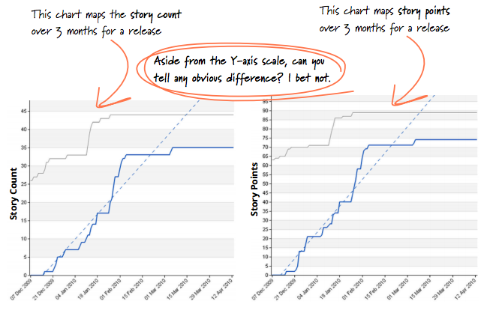
Story Counting
Still keep the estimations sessions. There are still high value on team conversation catalyzed by gauging the size of the work
Changed to follow progress using story count on burn up
Still use estimated points as reference for prioritization
Notes:
Introduced by Thoughtworks consulting company after experience in tens of projects with clients
Over time, when doing the distribution in groups ( like buckets ) by points, they saw that most of the stories were getting into the same bucket
Comparing the burn up graphs based on story points or number of cards, they started to look all the same, independent of the size of the cards after a span of 2 weeks.
Benefits :
Fewer metrics, more conversations – in estimation meetings, we have shifted focus from numbers to a collaborative conversation. This provides a better platform for our team to discuss and eventually establish a shared understanding about what to build and how. We noticed that subsequent development work became much smoother after these conversations.
Less math, more effective planning – in scope planning meetings where we used points, we had to scratch our heads to figure the exact number of points to put in ot take out. Freed up from these calculations, we focus more on business value and being more responsive to ad-hoc requirements.

Slide 15
In summary
Understand that each team’s approach to estimation evolves as the product progresses or team matures
Explore different ways to estimate and pick one that suits your team/product
Revisit the purpose of estimation
In agile model, the estimation is not to track progress against a plan. Its to help define scope of a release
As important as the estimation is the conversation and understanding it generates
Understand velocity is as important as understand the size of the story

Slide 16
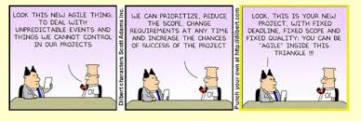
Thank you!!
“ So whenever you’re thinking of asking for an estimate, you should always clarify what decision that estimate is informing. If you can’t find one, or the decision isn’t very significant, then that’s a signal that an estimate is wasteful. “
Martin Fowler
@mattos_leonardo
Leonardo.mattos@gmail.com

